Slide 1

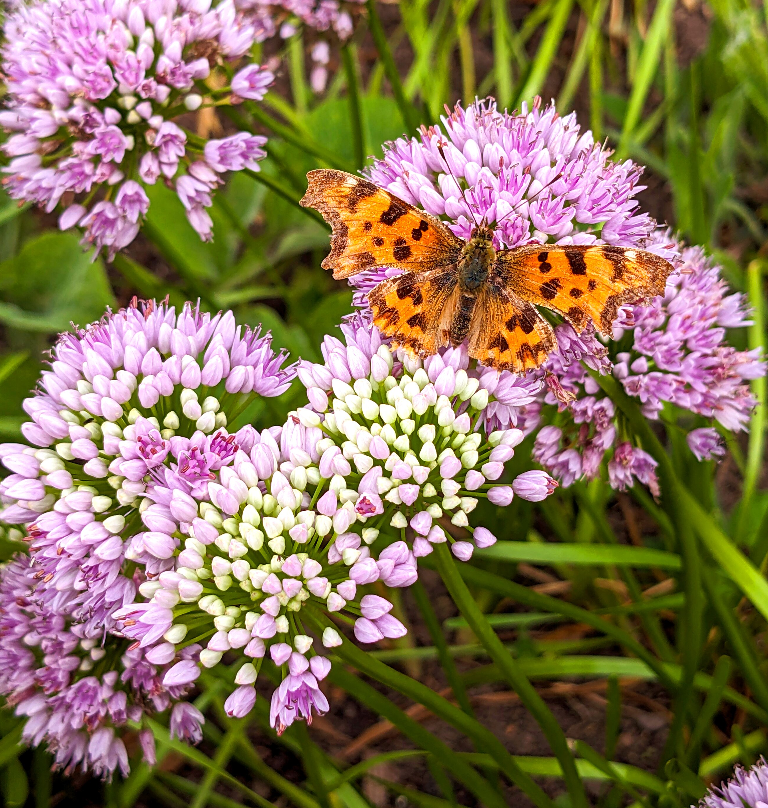

RHS Grow With It 2025
Create a pollinator pocket garden at your school
Comma butterfly on allium flowers

Slide 2

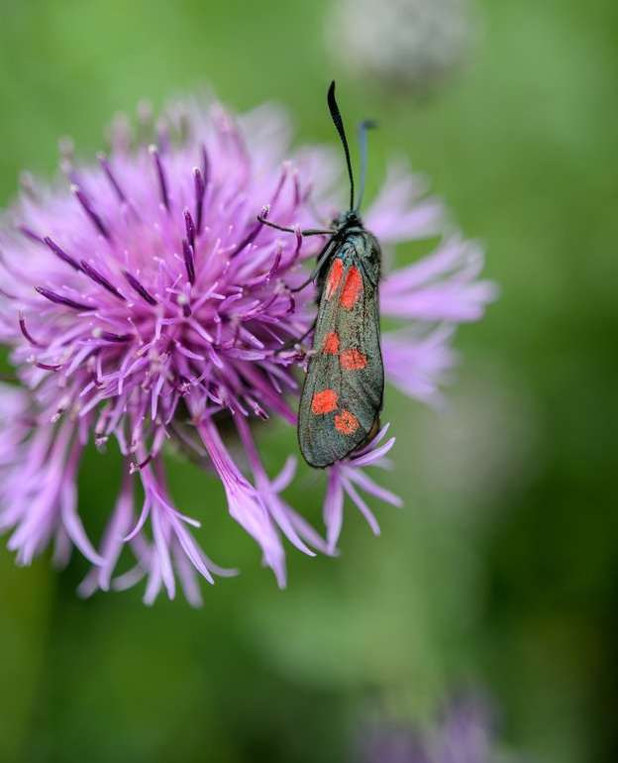
Key vocabulary
Environment: the surroundings in which any living thing is found
Habitat: a home for plants and animals
Nectar: sweet liquid, mainly produced in flowers
Pollen: dust-like grains, produced by the male parts of flowers
Pollinating: moving pollen from one flower or plant to another, resulting in the flower or plant being able to make seeds
Pollinators: animals that move pollen from one flower or plant to another e.g. bees
Sow: place a seed in soil or compost
Six-spot burnet moth on greater knapweed

Slide 3

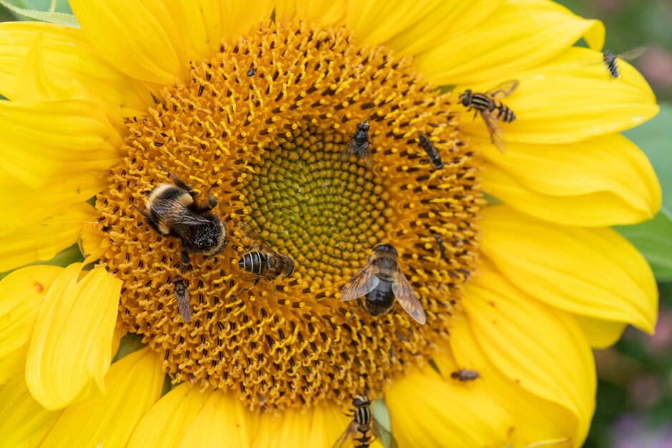
Introduction
What are pollinators and why are they important?
Pollinators are animals that move pollen as they travel from flower to flower. This needs to happen so that flowering plants can produce new seeds or fruit. Pollinators are attracted to flowers that produce the nectar and pollen which they feed on or feed to their young.
Pollinating insects on a sunflower
When the pollinator is visiting a flower, some pollen from the flower sticks to them and brushes off when they visit the next flower. If that flower is growing on the same type of plant and receives the pollen, it is said to be ‘fertilised’. The animal has then pollinated the flower. It will then go on to make seeds and often also fruit e.g. strawberries or apples.
Many pollinators are insects including bees, flies, beetles, moths, butterflies and wasps.

Slide 4
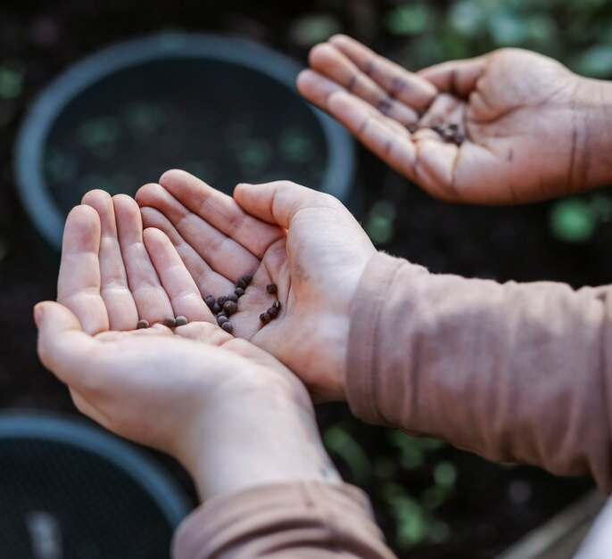
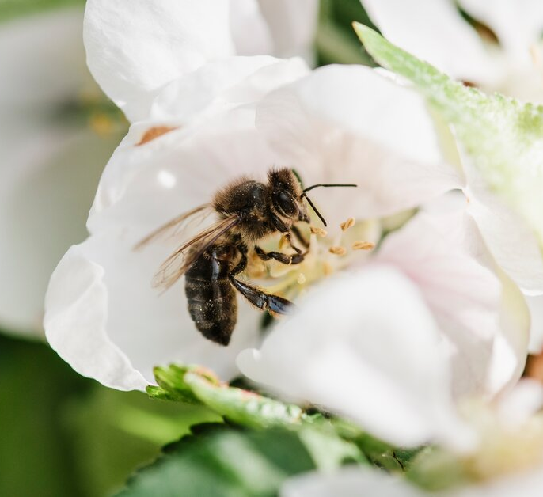
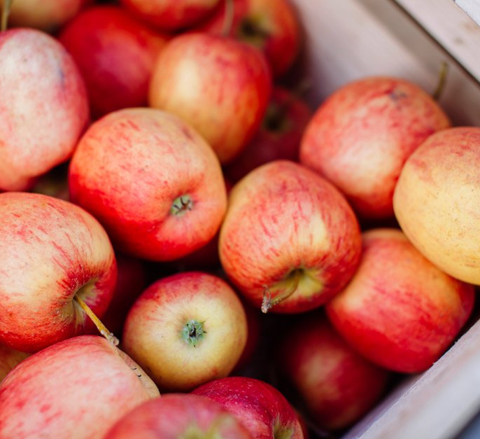
How helping pollinators helps us
Hands holding seeds
Honeybee on apple blossom
Apples in a crate
We can help pollinating insects by sowing seeds to grow plants with flowers rich in pollen and nectar.
When insects visit the flowers to feed, they pollinate them. The plant can then make seeds which grow into more plants.
Insects pollinate three quarters of the crops we eat. By helping pollinating insects, we are also making sure we have enough food to eat.

Slide 5

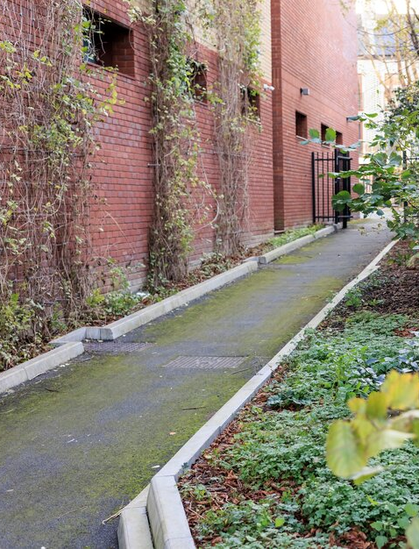
How we can help pollinators
Look out of the window - can you see any flowers for pollinating insects?
There is a lack of pollen and nectar-rich flowers available in many places for pollinating insects. Changes in how people manage land and the environment mean that the places where pollinating insects live are also changing. Habitat loss, a lack of pollen and nectar-rich flowers, climate change and pesticide use, are all related to actions by people and make it difficult for pollinating insects to survive.
Can you think of any ways we can help pollinating insects? There are lots of things we can do to help pollinating insects, including growing pollen and nectar-rich flowers, trees and shrubs, and providing drinking water, nesting places and nesting materials.
A school path with plants growing beside it

Slide 6
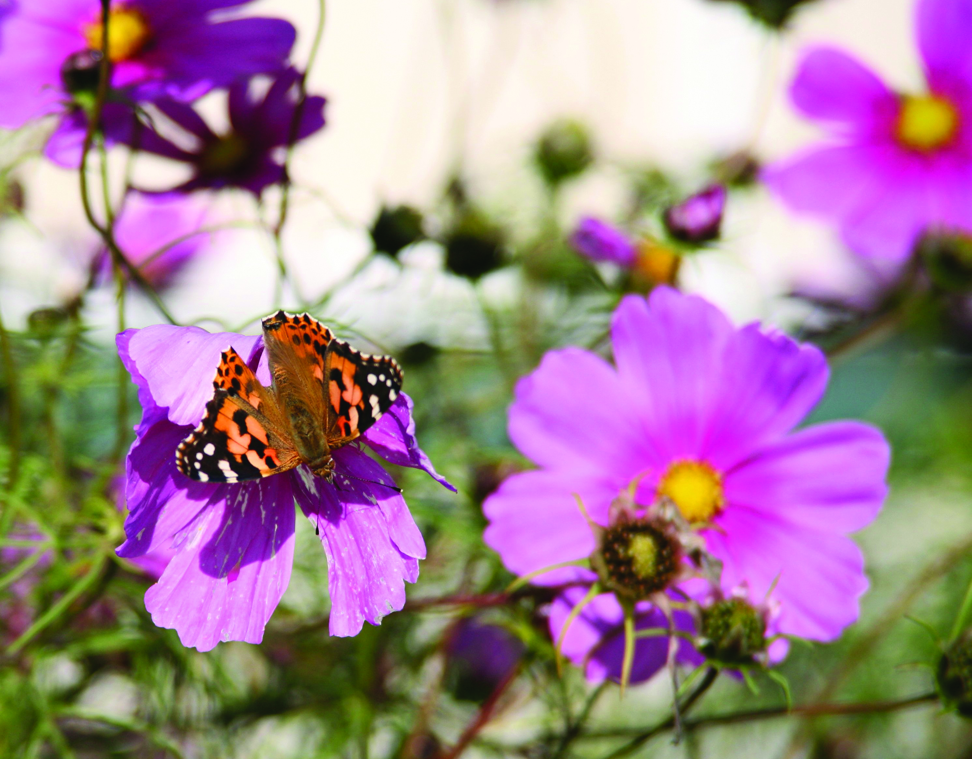
Growing flowers for pollinating insects
RHS Grow With It is inviting everyone to make a BIG difference by growing plants in small spaces.
Together, we can be active citizens by sowing seeds to create a pollinator-friendly pocket garden in our school grounds. The seeds that we sow will grow into flowers which pollinating insects can feed from.
After we've sown our seeds, we will add our space to the Grow With It map to show everyone the action we are taking.
Comma butterfly on cosmos flower
Notes:
Please note, if you don’t have an RHS Grow With It seed pack you can complete the activities in this session with other pollinator friendly plant seeds: Plants for pollinators guide / RHS Campaign for School Gardening

Slide 7


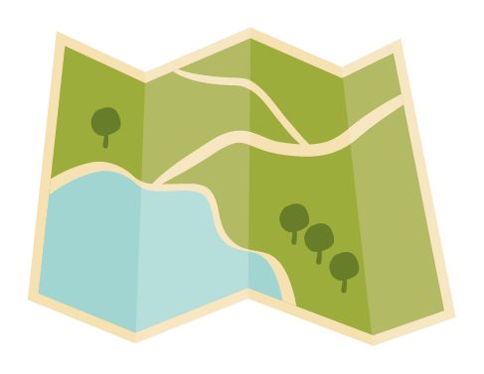

How will you take part?
Today you will...
1. Sow your seeds in a container or in the ground.
2. Label your seeds so that you know what you are growing.
3. Plot your pollinator pocket garden on the Grow With It map.
1. Sow your seeds to create a pocket garden for pollinators.
2. Label what you have sown so others know what is growing there.
3. Add your space to the Grow With It online map.
4. Look after your seeds and watch them grow. See what pollinators they attract when they flower.

Slide 8
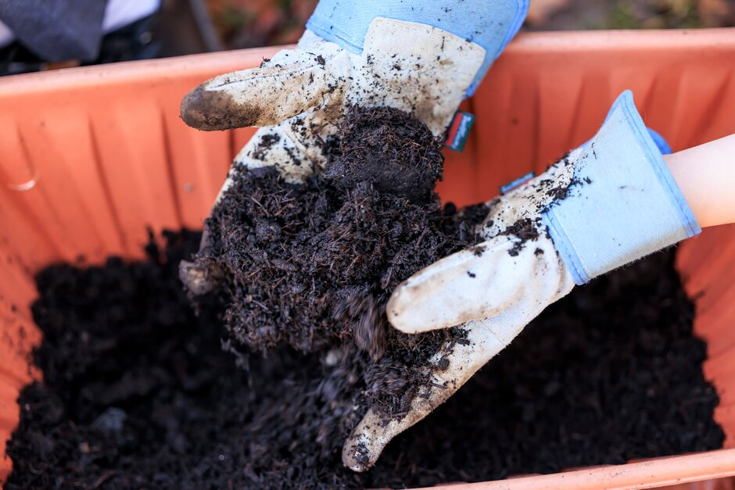

1. Sow your seeds
Sharing with others:
Plant any leftover seeds into small pots to give to friends and family members. Let them know that the pot needs to be kept outside in a nice sunny spot so that pollinating insects will be able to visit the flowers when they grow.
Hands in gardening gloves emptying compost into a container
Tell everyone about it:
Make a sign to tell other people in your school that these seeds will grow into flowers to help pollinators.
Notes:
Use our downloadable guides to sow your seeds into a container or in the ground (available as text only or Widgit guides)

Slide 9
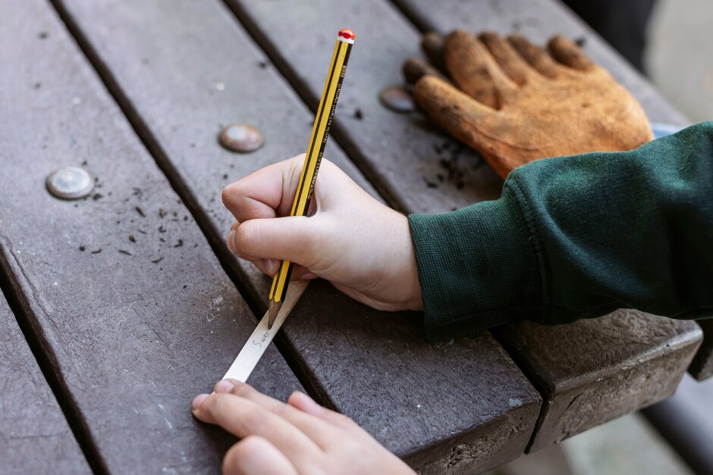

2. Label your seeds
It's important to label your seeds so that you remember what you have sown, and when.
This also lets others know where there are plants growing.
Use the printable labels provided to label your seeds – or create your own.
Writing on a plant label
A plant label should include:
Name of plant
Date seeds were sown
You can also add a picture of the plant. You could add some care tips.
Notes:
Use the printable labels provided as part of this lesson to label your seeds (available as photograph or Widgit versions) – or create your own.

Slide 10
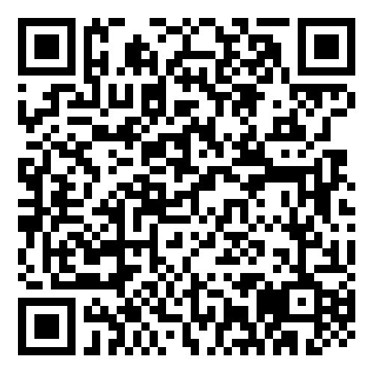
3. Plot your pocket garden on the map
Once you've sown your seeds, it's time to put your space on the map!
Use the link or scan the QR code to open the form. You will be able to add your school’s location and show everyone which seeds you've sown in your space.
As more people take action by sowing a small space for pollinators, the RHS Grow With It map will show the difference we are all making together.
Scan the QR code or click this link:
https://survey123.arcgis.com/share/6bc285a40c514a82bb9022a6de4a4993

Slide 11
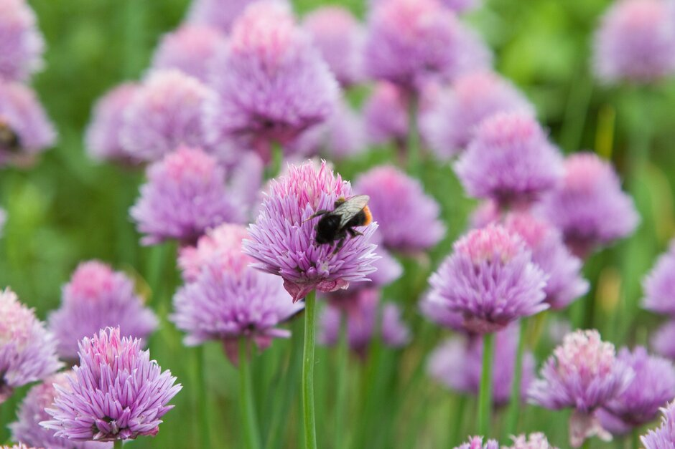
Assessment questions
How will the seeds you have planted today support pollinating insects in your community?
Do you need a large growing space to make a difference to pollinating insects?
How does sowing seeds for pollinators make us active citizens?
Plenary:
In pairs, discuss other spaces you know that could
be transformed for pollinating insects.
Bumblebee on chive flowers

