Slide 1
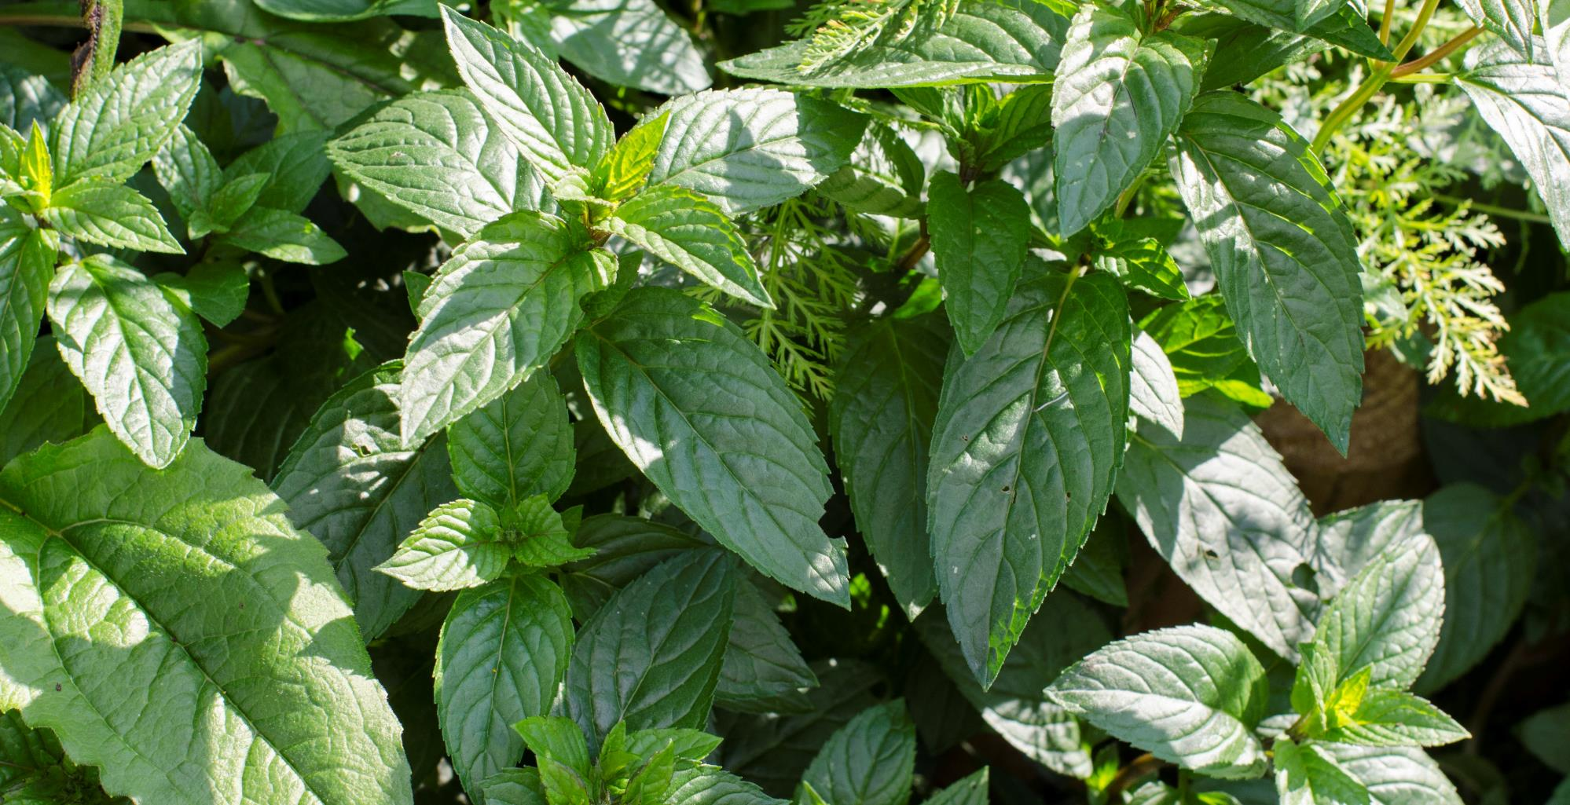
Asexual reproduction – Mint stem and root cuttings

Slide 2
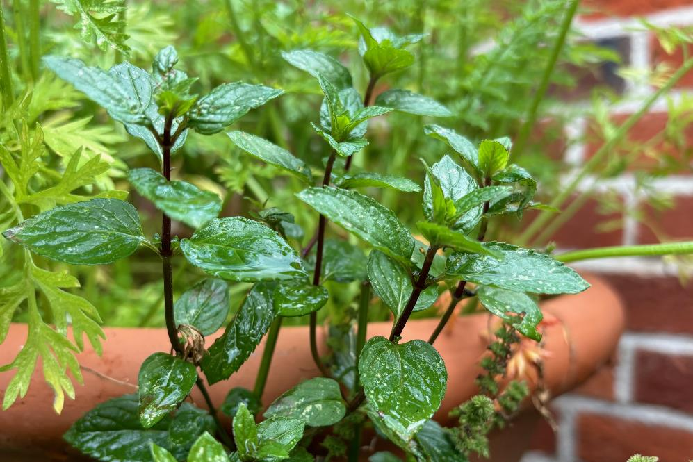
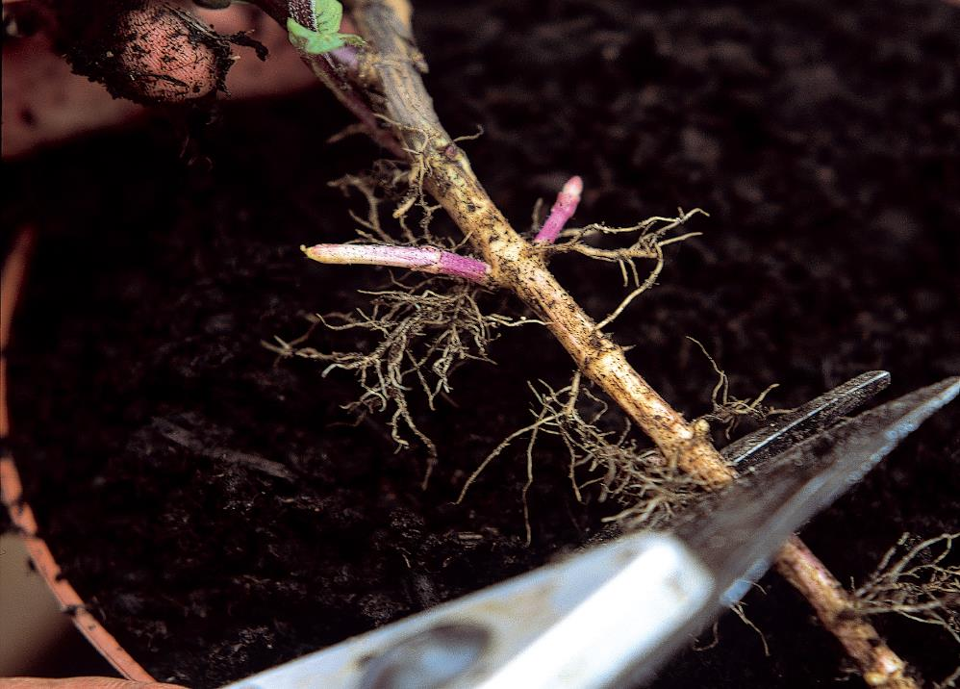
Nodes
A point on a stem where a leaf or branch emerges.
A point on a root where another root emerges.
Node

Slide 3

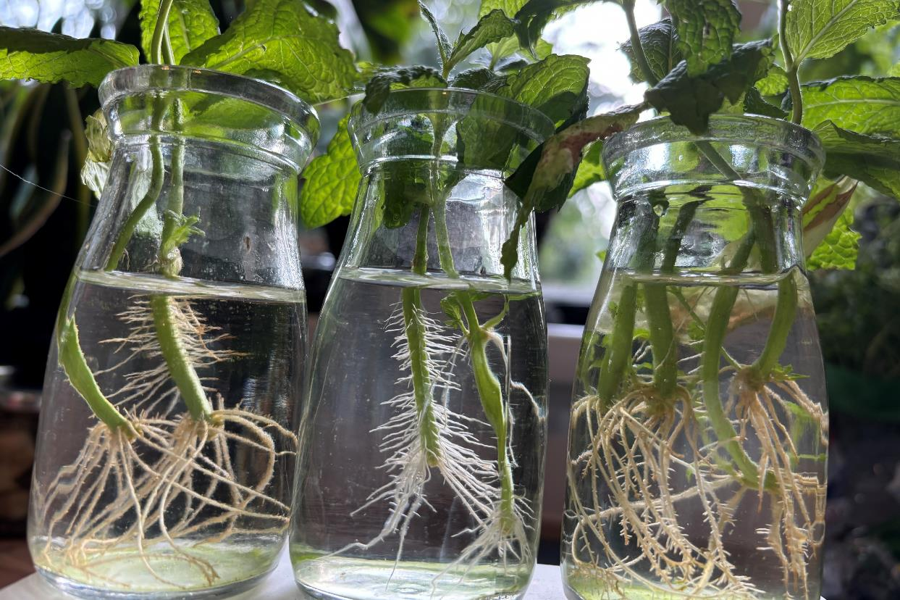
Stem cuttings
Cut a mint stem above a node.
Find a node on the removed stem and cut everything below the node away.
Remove any lower leaves.
Place in a jar of water.
Place on a windowsill.

Slide 4
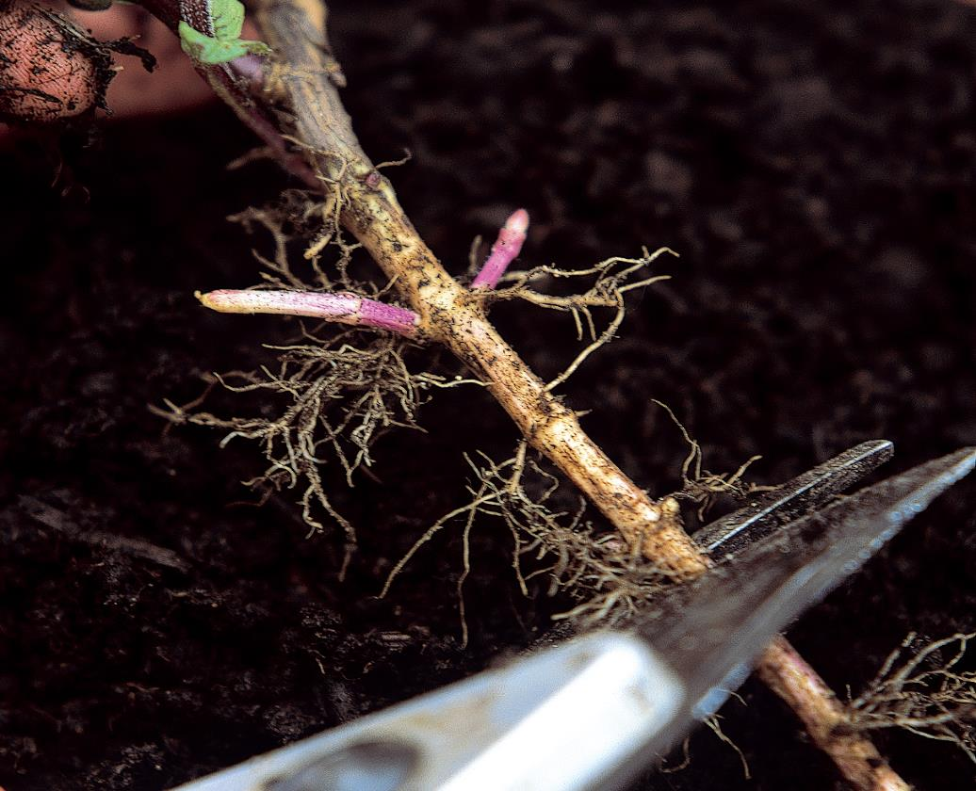
Root cuttings
Fill a pot with peat-free compost.
Take the mint out of its pot.
Find a thick white root.
Find a node and cut out that section of root (smaller than the diameter of the pot).
Make a small dip in the peat-free compost and lay the root cutting flat in the dip.
Cover the root cutting with peat-free compost.
Place on a windowsill or outside.
Node

Slide 5
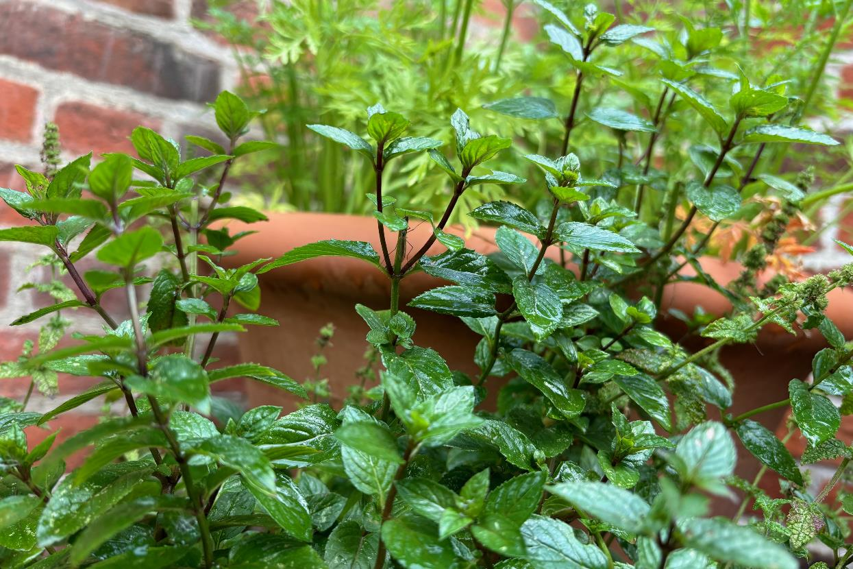
Reflections
Has anything surprised you today?
Think about any benefits for plants of making more plants via seeds or cuttings.
Think about any benefits for people of making more plants via seeds or cuttings.

